Slide 1
What are Fats?

Slide 2
Decide Which Has the Most Fat. Write your rank order in your journals. Do this by yourself, quietly!!!
A Skipper’s 2 Piece Fish and Chips w/Coleslaw?
A Subway Turkey Breast, Ham & Bacon Melt 6-inch Sub?
A McDonald’s Big Mac?
A Taco Bell Taco Salad with Shell?

Slide 3
The Rank Order from fattiest to least fattiest
McDonald’s Big Mac
Skipper’s Fish and Chips w/coleslaw
Taco Bell Taco Salad with shell
Subway 6-inch Turkey, Ham, and Bacon Melt

Slide 4
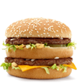
McDonald’s Big Mac
Contains 600 total calories
300 calories from fat
33 total grams of fat
51% of the daily value of fat
11 grams of saturated fat

Slide 5
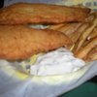
Skipper’s Fish and Chips w/Coleslaw
510 Calories total
260 calories from fat
29 grams of fat
11 grams of saturated fat

Slide 6
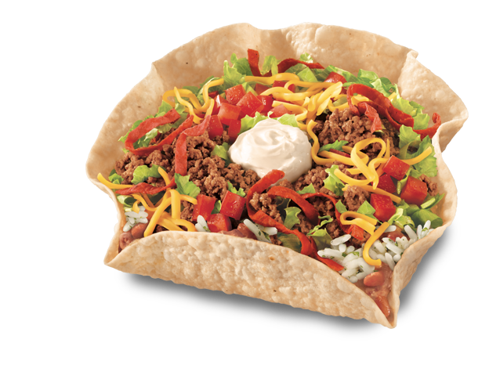
Taco Bell Taco Salad With Shell
500 total calories
240 calories from fat
27 total fat grams
42% daily value
12 grams saturated fat

Slide 7
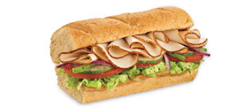
Subway 6-inch Turkey, Ham & Bacon Melt
380 total calories
110 calories from fat
12 total fat grams
5 saturated fat grams

Slide 8
Today’s Class Objectives
By the end of class today the student will be able to:
  Describe the differences between saturated, unsaturated, and trans fats.
  Name foods that contain each of these different types of fats.
  List roles of fat in the human body.
  Tell ways that a person could cut the fat when ordering out at a restaurant.

Slide 9
What are Fats?
Fats are fatty substances that do not dissolve in water.
Fats are composed of the same three elements as carbohydrates. Carbon, hydrogen, and oxygen
They can be referred to as lipids.
30% of your overall diet’s calories should come from fat

Slide 10
Types of Fats
Saturated Fats
Fats that are usually solid or semi solid at room temperature. Think of butter…
Found in animal products (i.e. butter, lard, and dairy products)
This type of fat can be harmful to your health!

Slide 11
Types of Fats Contd.
Unsaturated Fats—Fats that are usually liquid at room temperature
This type of fat is found in vegetable oils, nuts, seeds, as well as seafood.
Unsaturated fats can help fight heart disease!

Slide 12
Types of Fats Contd.
Trans Fats—are made by manufacturers adding hydrogen to the fat molecules in vegetable oils.
Trans fats cause foods to stay fresher longer.
Trans fats have little to no benefits to health and are found in things like margarine, chips, and commercially baked goods.

Slide 13
What Are Sources of Fat?
Visible Fats—butter, margarine, vegetable oil, and the fat layer on meat and poultry. (40% of our diet seems to contain this type of fat)
Hidden Fats—Marble in meat, chocolate, seeds, nuts, egg yolks, ice cream, cheese, cream soups, croissants, and donuts.

Slide 14
Roles of Fats
Fats provide essential fatty-acids that our bodies cannot make
Ounce by ounce fats supply the body with twice as much energy as carbohydrates.
Fats carry fat-soluble vitamins A,D,E, and K into your blood
Fats add flavor to our food, and help satisfy our hunger because they take longer to digest than carbohydrates
Adipose Tissue—helps protect our bodies and our organs (it is a protective layer of fat surrounding our organs)

Slide 15
Cholesterol
Cholesterol is a waxy, fatlike substance that is found only in animal products.
Your body needs cholesterol to aid in the digestion process.
Your liver can make all that your body needs. The liver uses cholesterol to make bile and get rid of waste
A diet high in cholesterol can lead to heart disease and congestive heart failure.

Slide 16
What Is Coronary Artery Disease?
Coronary artery disease (CAD), also called coronary heart disease, is a condition in which plaque (plaque) builds up inside the coronary arteries. These arteries supply your heart muscle with oxygen-rich blood.
Plaque is made up of fat, cholesterol (ko-LES-ter-ol), calcium, and other substances found in the blood. When plaque builds up in the arteries, the condition is called atherosclerosis (ATH-er-o-skler-O-sis).

Slide 17
Coronary Disease
Coronary angioplasty (AN-jee-o-plas-tee), is a procedure used to open clogged heart arteries. Angioplasty involves temporarily inserting and blowing up a tiny balloon where your artery is clogged to help widen the artery.
Angioplasty is often combined with the placement of a small metal coil called a stent in the clogged artery to help prop the artery open and decrease the chance of it narrowing again (restenosis). Some stents are coated with medication to help keep your artery open (drug-eluting stents) while others are not (bare-metal stents).

Slide 18
Coronary Disease cont.
Angioplasty can improve some of the symptoms of blocked arteries, such as chest pain and shortness of breath. Angioplasty can also be used during a heart attack to quickly open a blocked artery and reduce the amount of damage to your heart.

Slide 19
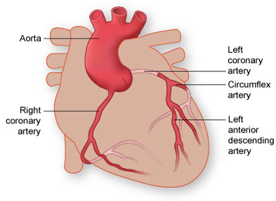
The Coronary Arteries
Coronary Circulation

Slide 20
Atherosclerosis
Figure A shows a normal artery with normal blood flow. Figure B shows an artery with plaque buildup.
Plaque narrows the arteries and reduces blood flow to your heart muscle. It also makes it more likely that blood clots will form in your arteries. Blood clots can partially or completely block blood flow.

Slide 21
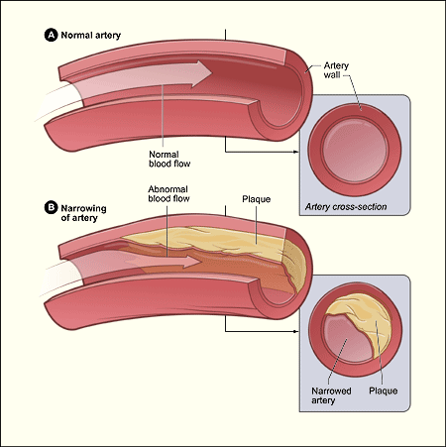
Atherosclerosis

Slide 22
How Can You Reduce Fat in Your Diet?
Choose better sources of foods
Eat more nutrient containing foods
Eat low fat foods
Trim off fat when cooking or preparing foods

